Slide 1
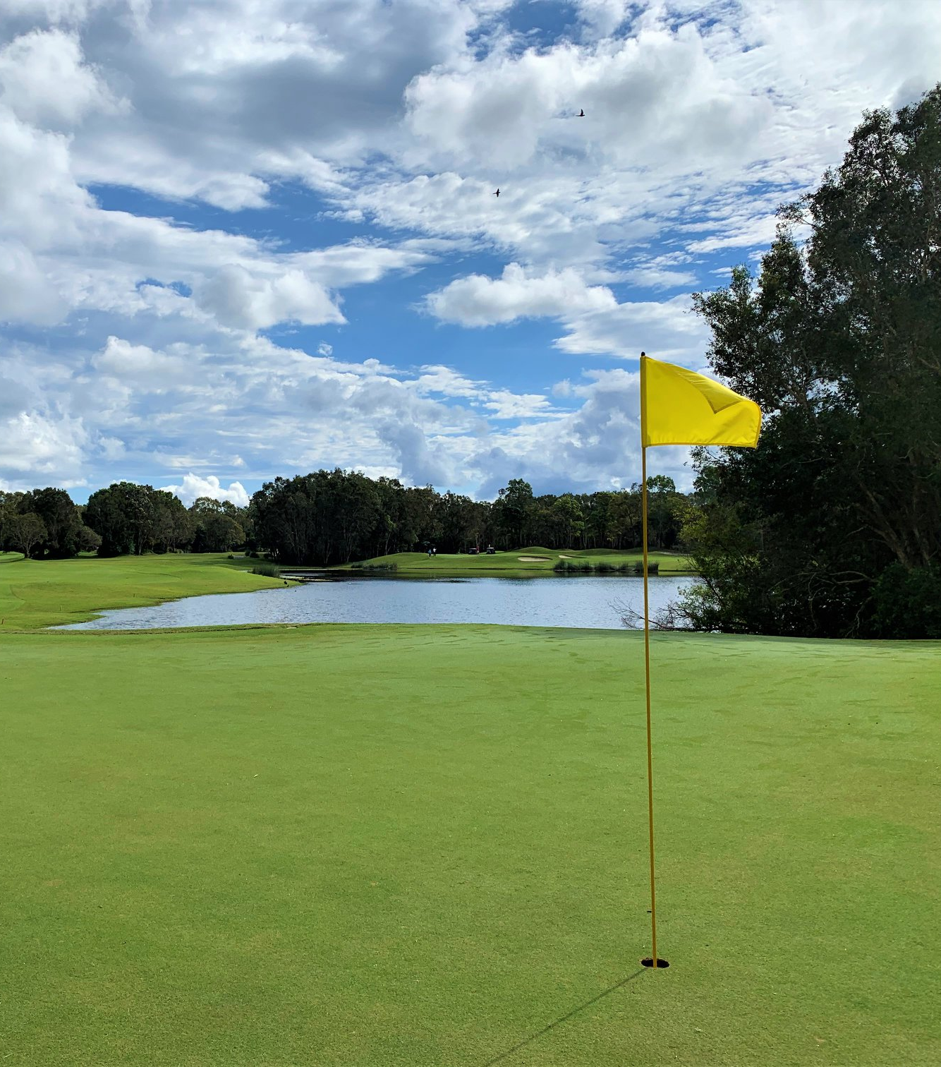


Slide 2

Dear Prospective Sponsor, We are reaching out to invite you to be a part of an exceptional event that combines community spirit with the love of golf. The Sunshine Coast Law Association (SCLA) is proud to announce its upcoming Golf Day, an event dedicated to supporting the invaluable work of the Suncoast Community Legal Service (SCLS). Through this event, we aim to raise funds and awareness for SCLS, a cornerstone in providing legal assistance to those in need within our community. This brief outlines various sponsorship opportunities, each designed to offer significant visibility and engagement with participants and attendees.

Slide 3
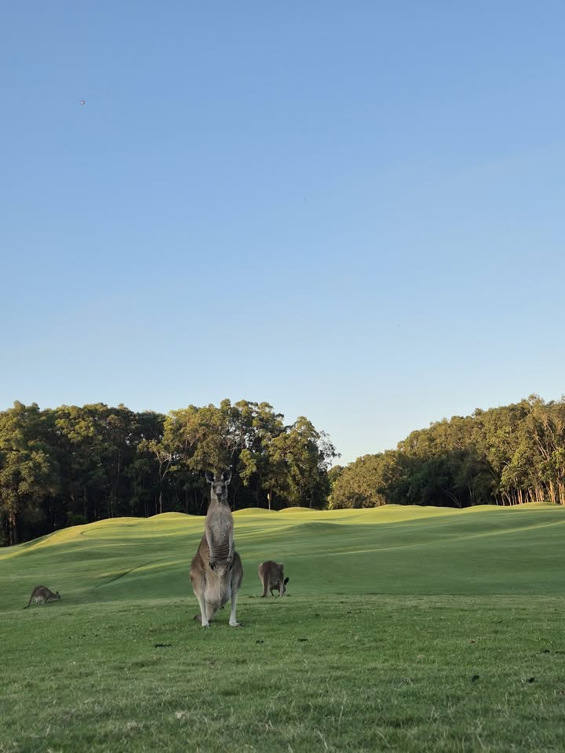
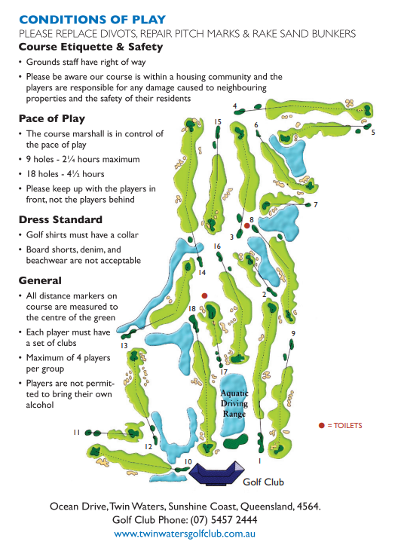
SCLA Golf Day 2025
Friday 29 August 2025 11am – 6pm

Slide 4
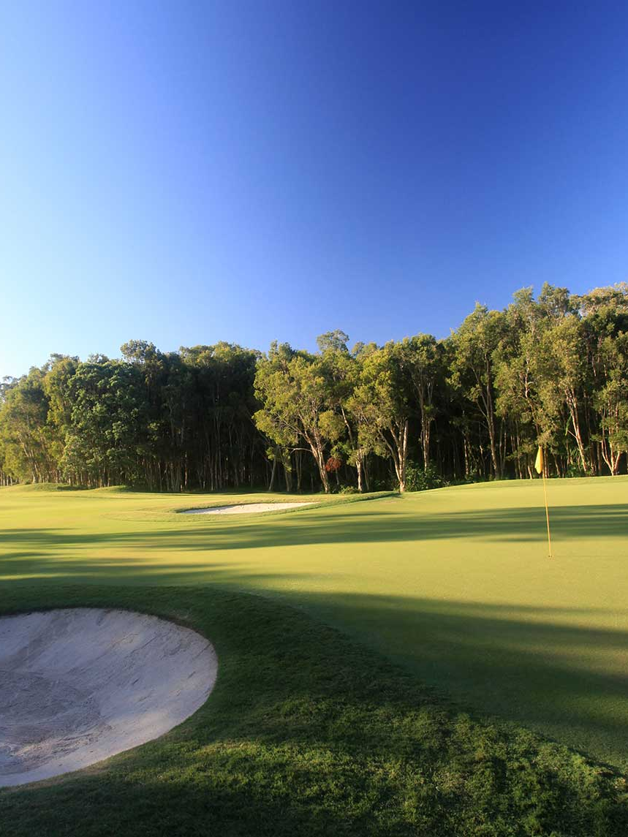
Why Sponsor?
Sponsoring the SCLA Golf Day offers a unique opportunity to:
Enhance your brand visibility among a distinguished audience
Demonstrate your commitment to supporting local community services
Engage with potential clients and partners in a relaxed and friendly environment
Enjoy a day of golf while contributing to a worthy cause

Slide 5
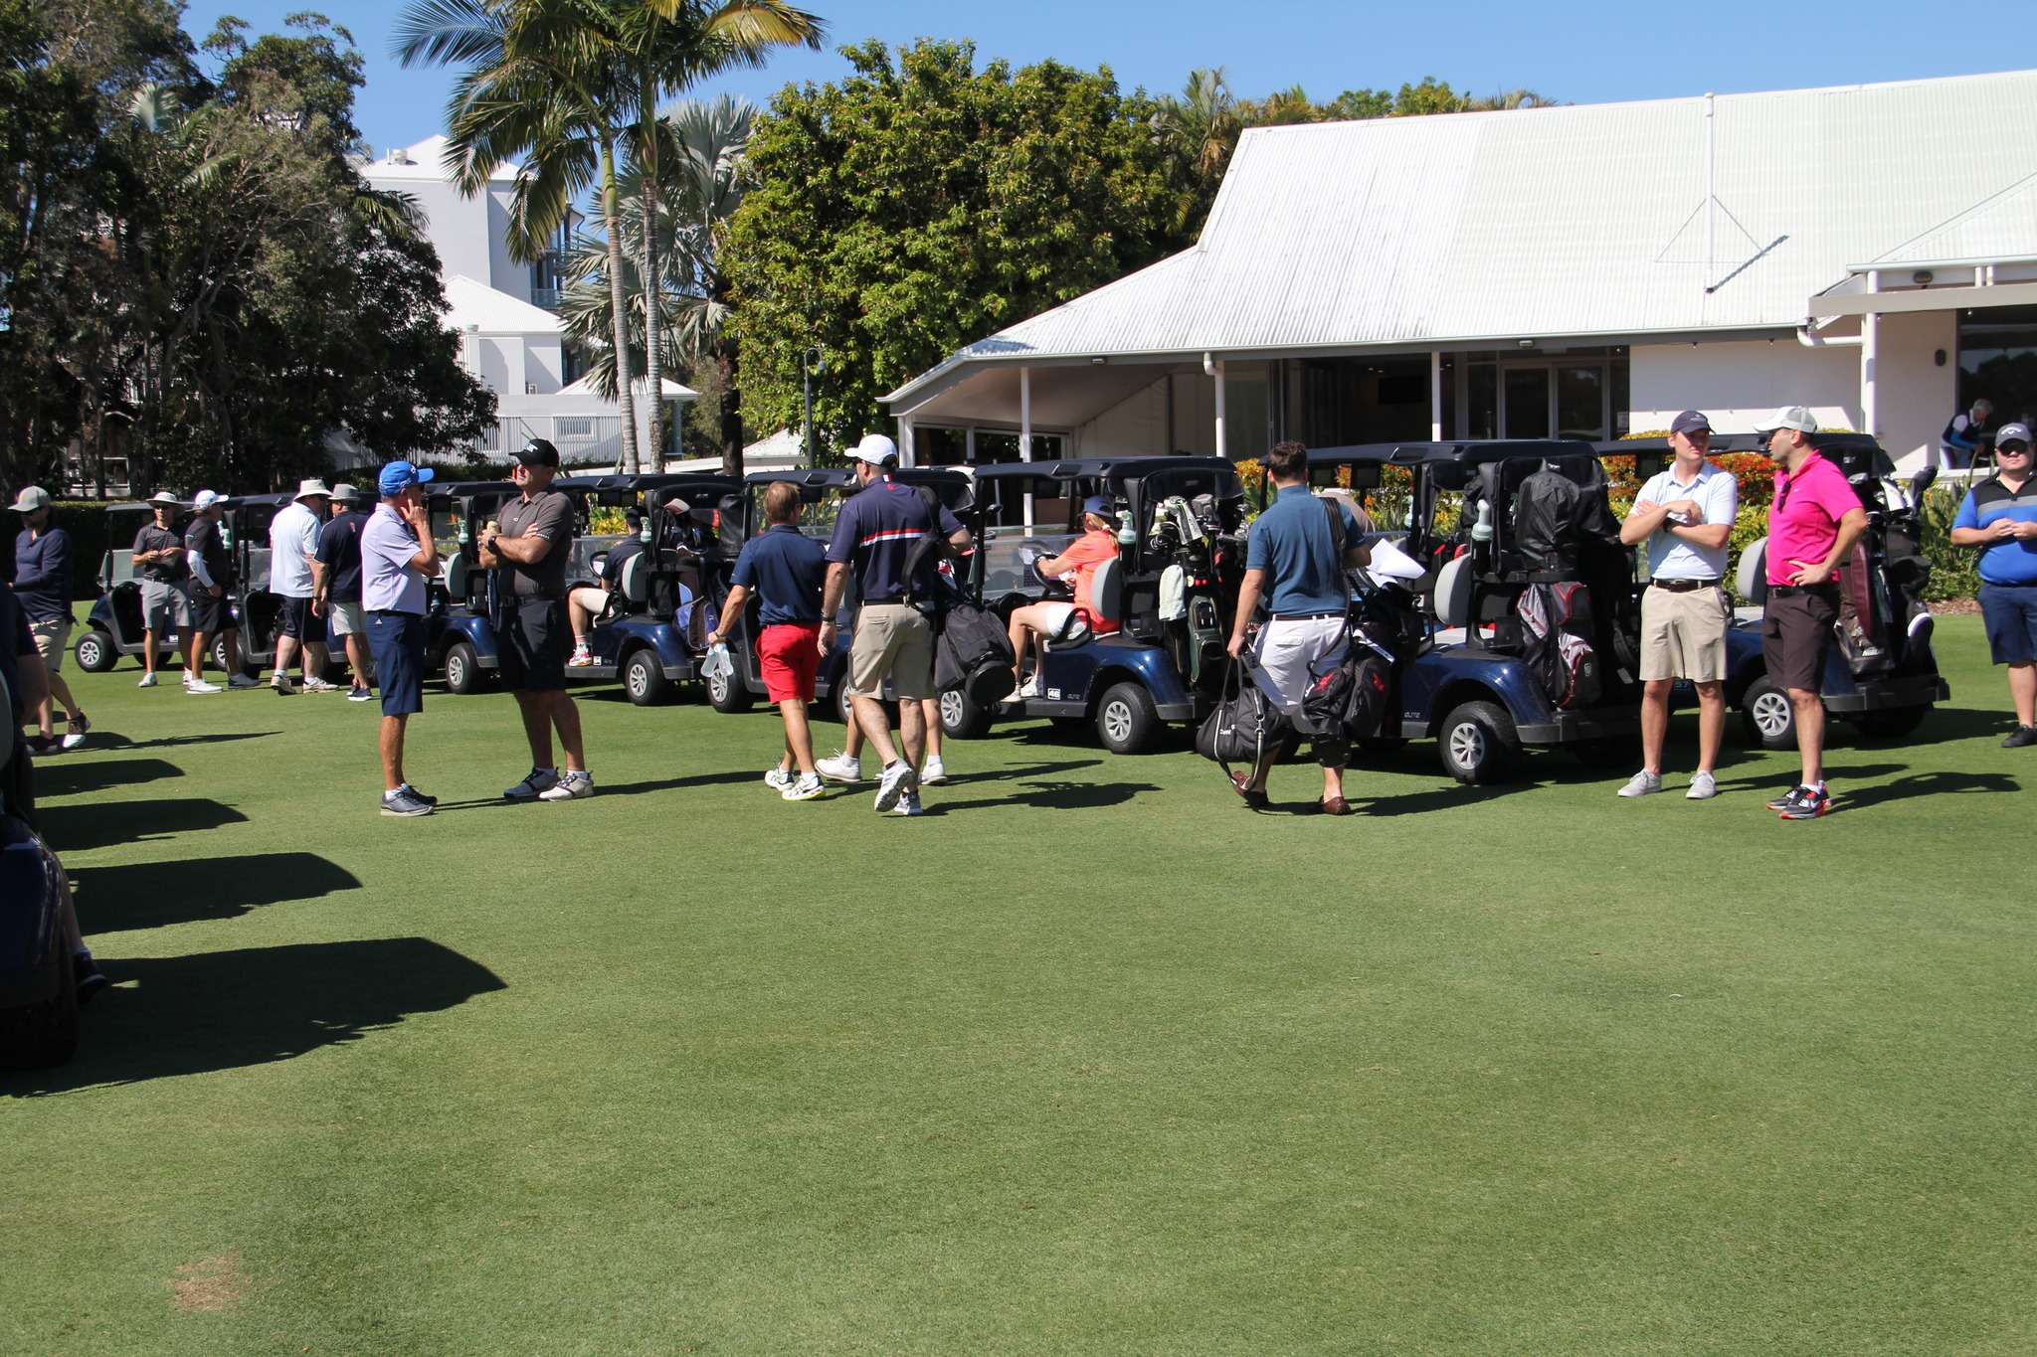
SOLD OUT!
Tier 1: Naming Rights
Exclusive naming rights for the event
$1,000 donation to SCLS
Includes 2 teams of 4 players for the event
Opportunity to have a marquee, sign, merchandise and representative/s on the hole
Lunch (sandwiches and water) for players and hole representative/s on arrival and 5 drink tickets per player
Opportunity to speak during the presentation ceremony
$5,000

Slide 6
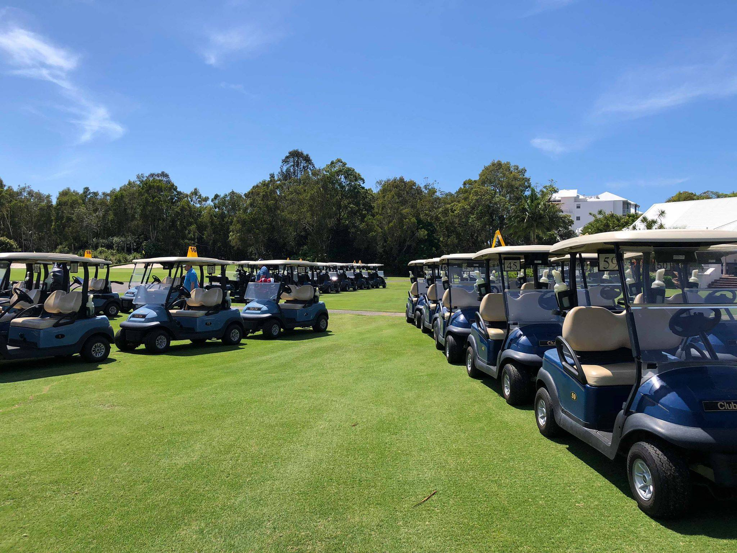
Tier 2: Hole-in-one Competition Hole
Sponsorship of a hole with a 'hole-in-one' prize
Insurance policy to cover the major prize for a hole in one, which is $10,000 with $10,000 donated to SCLS
Includes 1 team of 4 players for the event
Opportunity to have a marquee, sign, merchandise and representative/s on the hole
Lunch (sandwiches and water) for players and hole representative/s on arrival and 5 drinks tickets per player
$2,000

Slide 7
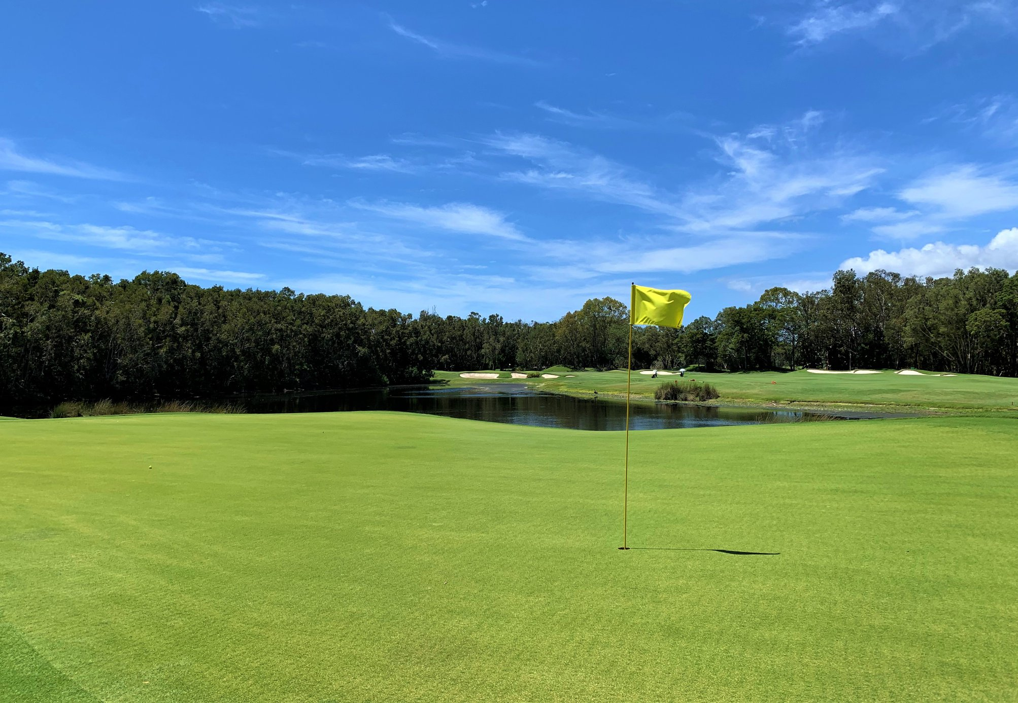
Tier 3: Novelty Competition Hole
Opportunity to have marquee, sign, merchandise and representative/s on the hole
Competition prize included and arranged by SCLA (e.g. longest drive, nearest to pin)
Option to run a novelty game on the hole- to supply own activity and prizes for the novelty game (optional)
Includes 1 team of 4 players for the event
Lunch (sandwiches and water) for players and hole representative/s on arrival and 5 drinks tickets per player
$1,500

Slide 8
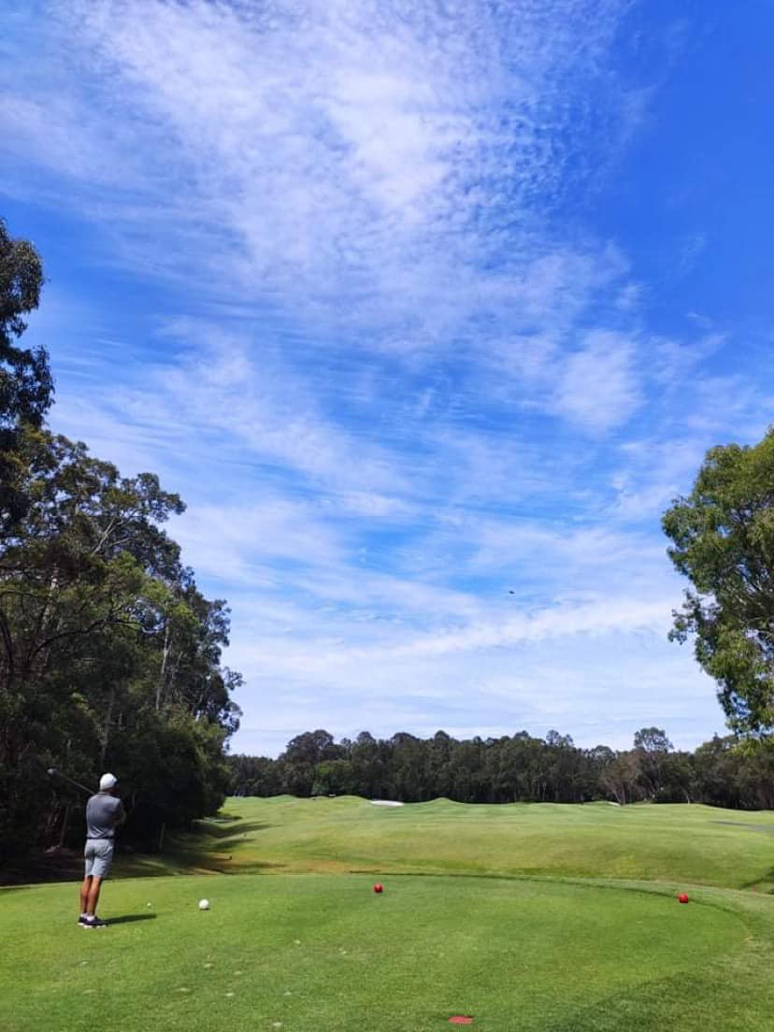
Tier 4: Sponsored Hole
Opportunity to have marquee, sign, merchandise and representative/s on the hole
Sponsor to arrange own prize for raffle
Includes 1 team of 4 players for the event
Lunch (sandwiches and water) for players and hole representative/s on arrival and 5 drinks tickets per player
$1,200

Slide 9
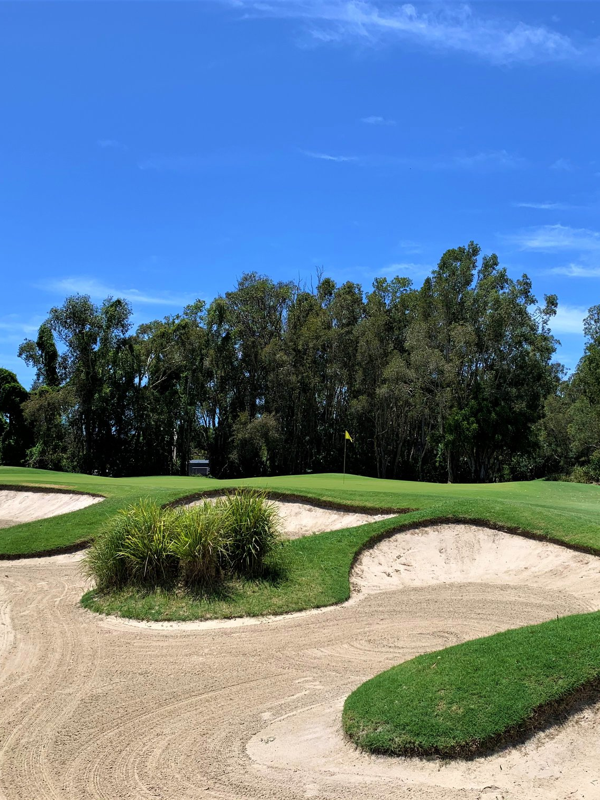
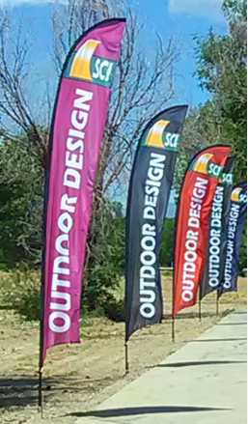
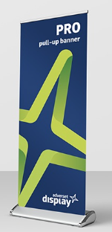

Tier 5: Signage Sponsor
Opportunity to display signage on a hole (must be outdoor suitable e.g. feather banner/ A-frame); or
Opportunity to display signage in the club house/registration area (suitable for pull-up banners).
$250
Note: sign placing it at the discretion of the venue on the day and can change at short notice due to weather/safety.
Indoor
Outdoor signs

Slide 10
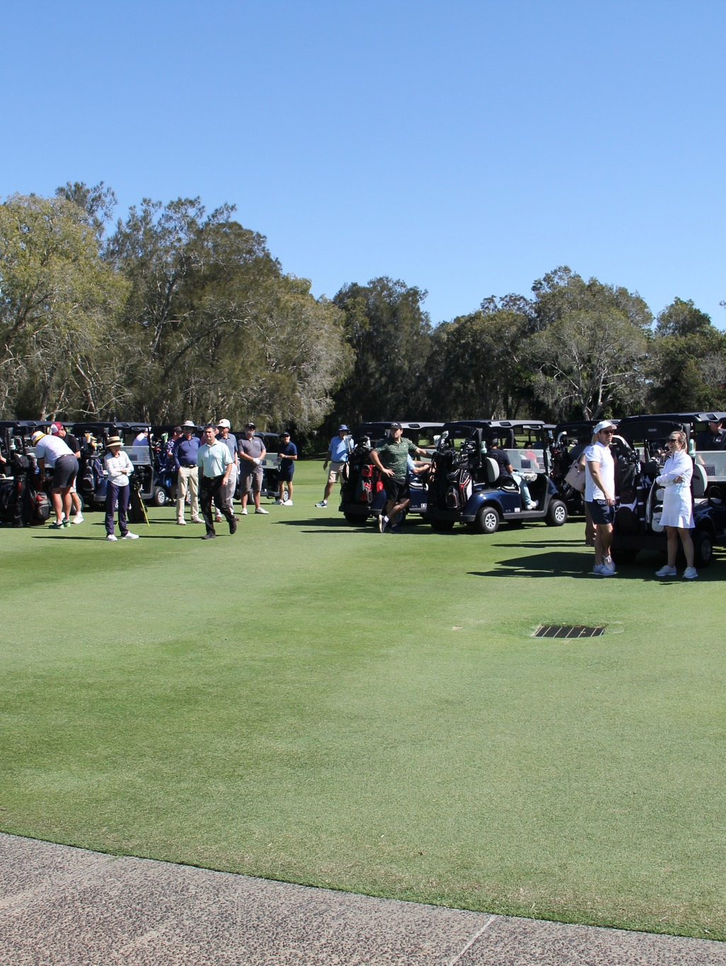
THANK YOU!
Your sponsorship is not just a business decision; it's a statement of your values and a direct contribution to making a difference in the lives of those who rely on the services of the Suncoast Community Legal Service. By joining us as a sponsor, you become a part of a community effort to ensure access to justice for all, regardless of their financial situation.
For more information, please contact us:
Rozlyn Spring roz@axialawyers.com.au
Callum Lee callum@pippacolman.com

